Slide 1


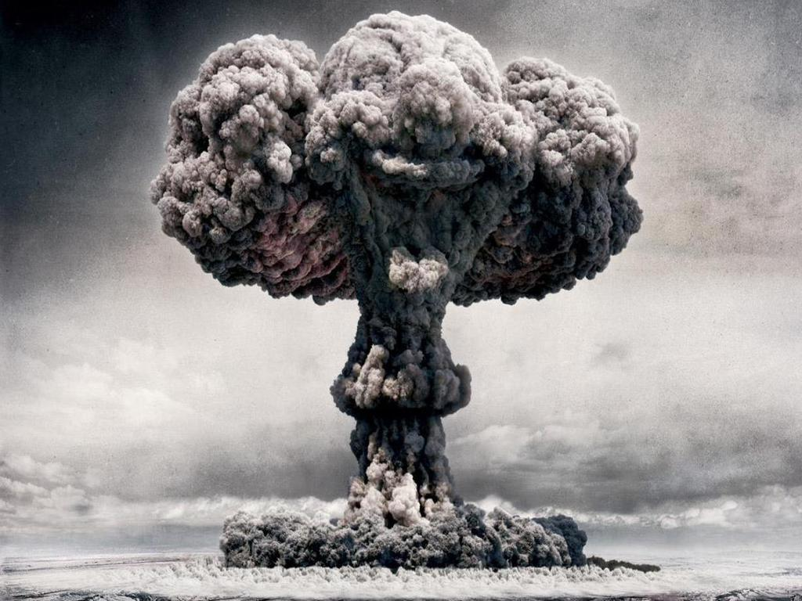
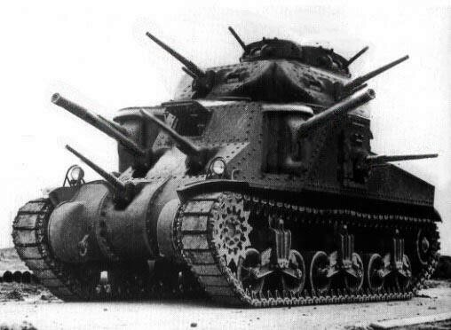

Selling War
Michael Szalay
Humanities Core, Winter 2014

Slide 2
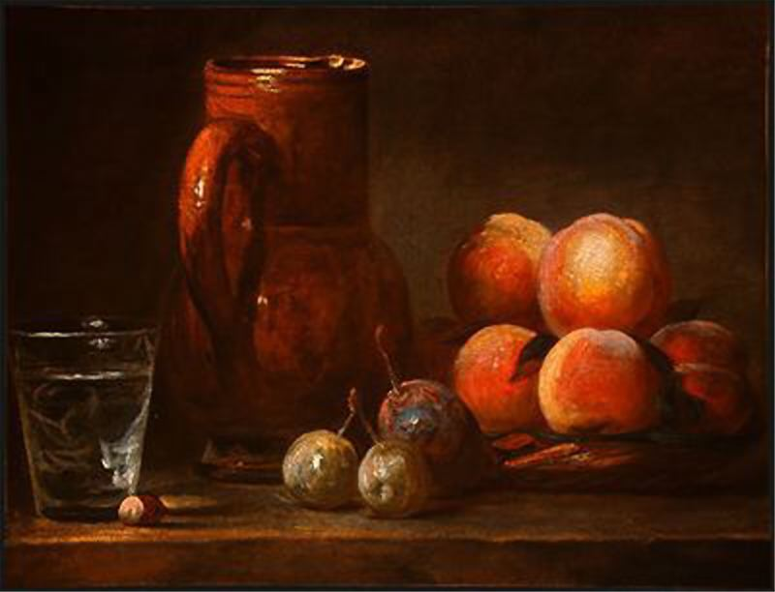
“There are several small paintings by Chardin…Nearly all represent fruit and the accessories of a meal. They are nature itself; the objects seem to come forward from the canvas and have a look of reality which deceives the eye…When I look at other artist’s paintings I feel I need to make myself a new pair of eyes; to see Chardin’s I only need to keep those which nature gave me and use them well….”
–Denis Diderot, 1763

Slide 3
Immediacy
(“They are nature itself.”)
“While a medium is often depicted as a window onto a vision or an experience, immediacy is the absence of that window and is instead the presence of the viewer within the vision or experience itself. . . . By its very definition, ‘immediacy’ through a manipulation of either time or space, connects two distinct entities, thus negating binary oppositions. The oppositions of artist/audience, time/space, cause/effect, artist/medium, action/stasis, real/abstract are all sent into far more confused and clouded relations once immediacy enters and the producer or observer attempts to connect the opposing elements.”
              Ariana Weisel
              http://lucian.uchicago.edu/blogs/mediatheory/keywords/immediacyimmediate/

Slide 4
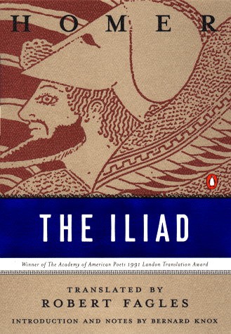
“Rage--Goddess, sing the rage of Peleus’ son Achilles, murderous, doomed, that cost the Achaeans countless losses.”
The Iliad, Book One
“It is vividness as a feature of divine epiphany that is involved in poetry’s power to make the invisible past appear to its hearers. The first words of each poem effect this appearance by calling on the muses: because we are granted their perspective, when the great speeches are given we seem to be on the edge of the assembly and when the heroic actions are performed, we seem to be present as onlookers.”
Andrew Ford, Homer: the Poetry of the Past, 55.

Slide 5
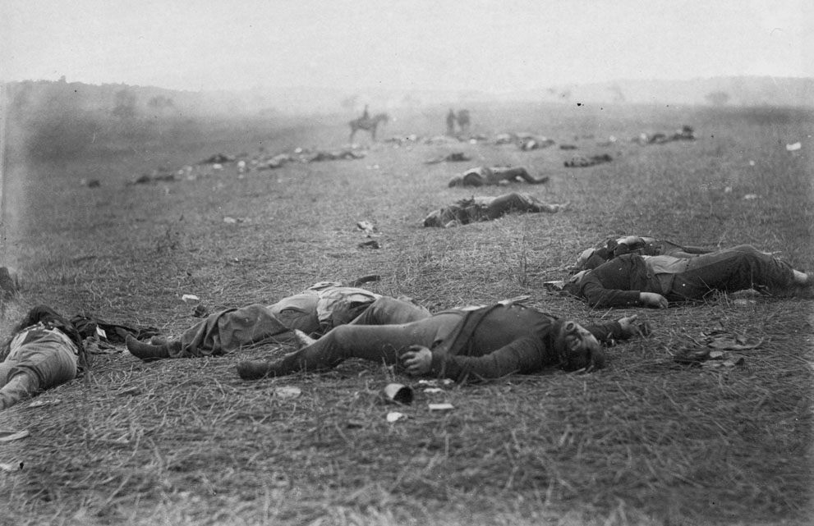

Slide 6
“The Vicarious War” and “The Real War”
“Mr. Brady has done something to bring home to us the terrible reality and earnestness of war. If he has not brought bodies and laid them in our dooryards and along the streets, he has done something very like it..”
          NY Times, October 20, 1862

Slide 7
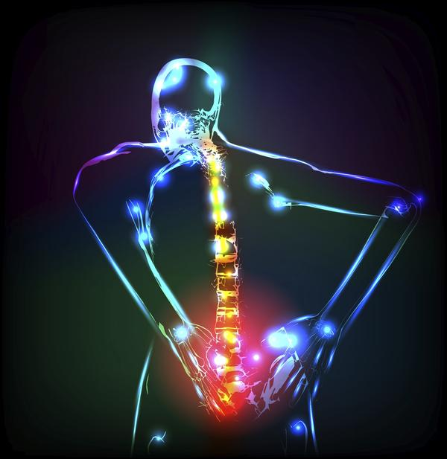
The Immediacy of Pain: Inimical to Language?
“English, which can express the thoughts of Hamlet and the tragedy of Lear has no words for the shiver or the headache. . . . The merest schoolgirl when she falls in love has Shakespeare or Keats to speak her mind for her, but let a sufferer try to describe a pain in his head to a doctor and language at once runs dry.”
Virginia Woolf, quoted in Elaine Scarry, The Body in Pain, 4

Slide 8
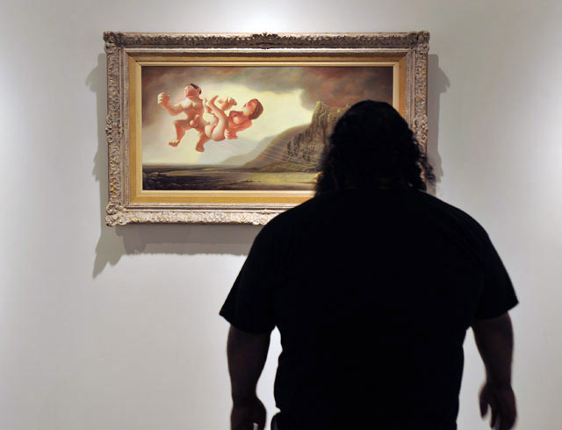
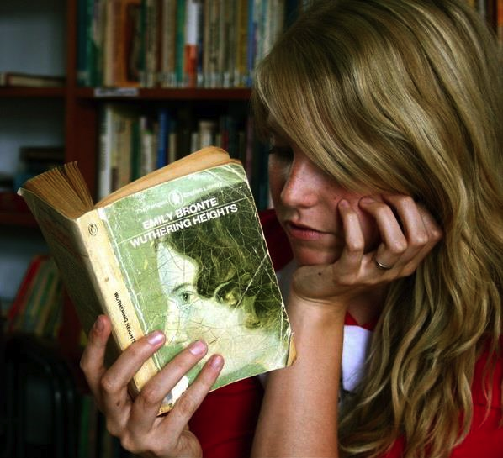
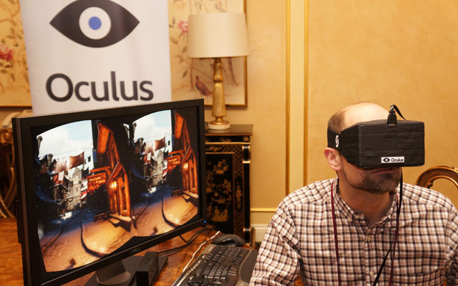
Change and Continuity, Across Media

Slide 9

IMMEDIACY

Slide 10
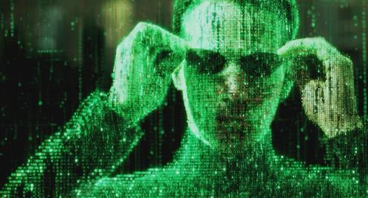
“Stadiums, for example. Airports. The interstate highway system. Wars. He wants to know how it is paid for, where do the billions come from? He imagines a shadowy, math-based parallel world that exists not just beside but amid the physical world, a transparent interlay of Matrix-style numbers through which flesh-and-blood humans move like fish through kelp. This is where the money lives, an integer-based realm of code and logic, geometric modules of cause and effect. The realm of markets, contracts, transactions, elegant vectors of fiber-optic agency whereby mind-boggling sums of mysterious wealth shoot around the world on beams of light. It seems the airiest thing there is yet the realest, but how you enter that world he has no idea… (121).
Metaphor and Double Vision

Slide 11
The difference between “immediate speech” (or “interior monologue”) and “free indirect speech”
In immediate speech, “The reader [is] installed in the thought of the main character from the first lines on, and it is the uninterrupted unfolding of that thought which, substituting completely for the customary form of narrative, apprises us of what the character does and what happens to him.”
              James Joyce
“In free indirect speech, the narrator takes on the speech of the character, or, if one prefers, the character speaks through the voice of the narrator, and the two instances are then merged; in immediate speech, the narrator is obliterated, and the character substitutes for him” (174).
              Gerard Genette, Narrative Discourse: An Essay in Method, 174.

Slide 12
“It seems the airiest thing there is yet the realest, but how you enter that world he has no idea except by passage through that other foreign country called college, and that ain’t happening. He will not return to the classroom, ever, the mere thought inflames a whole host of piss-offs and associated grudges that go all the way back to kindergarten, not to mention the sheer soul-sucking boredom of those years. If there is real knowledge to be had in the Texas public schools he never found it, and only lately has he started to feel the loss, the huge criminal act of his state-sanctioned ignorance as he struggles to understand the wider world. How it works, who gains, who loses, who decides. It is not a casual thing, this knowledge. In a way it might be everything. A young man needs to know where he stands in the world, not just as a matter of basic human dignity but as determinants in the ways and means of survival, and what you might hope to gain by application of honest effort—” (121)

Slide 13
Are the novel’s word cascades more immediate?
          terrRist
          freedom
evil
nina leven
nina leven
troops
currj
support

Slide 14
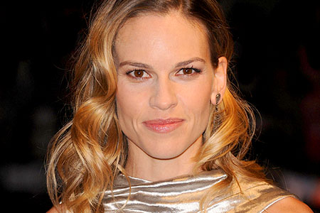
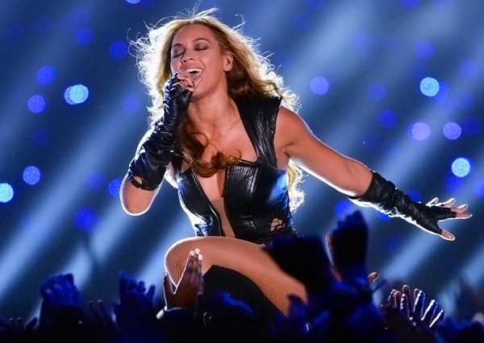
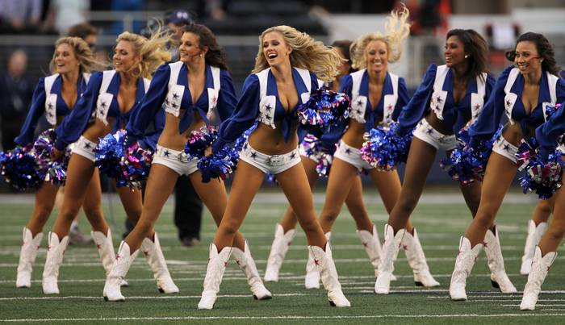
Billy Lynn: an object of the gaze?
“Part of being a soldier is accepting that your body does not belong to you” (206)
“It’s not right. Nobody said anything about this. What might be merely embarrassing in real life is made obscene and hostile by TV” (239).

Slide 15
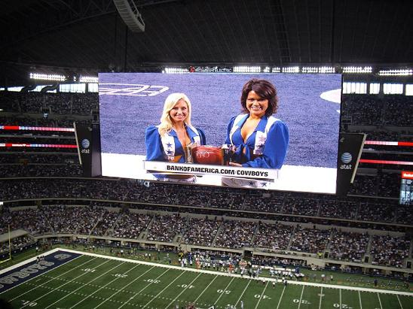
“So what do you believe in? Billy doesn’t so much wonder as feel the question thrust upon him. . . . How about . . . reality. Billy decides the war has made him a convert to the Church of What It Is. . . .”
“For several minutes he tries to concentrate on the game, but it’s too slow, like riding an elevator that stops on every floor. It’s not like you’re supposed to watch the actual game anyway, no, you watch the Jumbotron, which displays not just the game in real and replay time but a nonstop filler of commercials, a barrage of sensory overload that accounts for far more content than the game itself. Could it be that advertising is the main thing? And maybe the game is just an ad for the ads” (220).

Slide 16
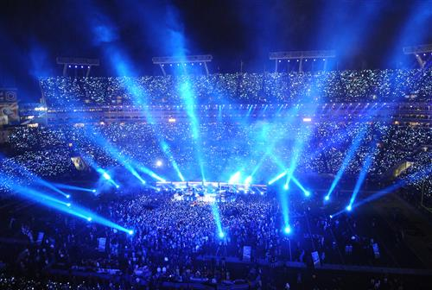
“Later, watching the performance on YouTube, Billy will start to piece together the enormous scale of it. . . . The proverbial cast of thousands” (229).
“ . . . the disco lights get going, rows of blue and white strobes trimming the steel-pipe frame and everything flashing all at once, electro-visual spaz-pulse and epileptic overload, retinal scarring, frontal lobes blown to caterpillar fuzz—”
“If there was ever a prime-time trigger for PTSD you couldn’t do much better than this” (230)

Slide 17
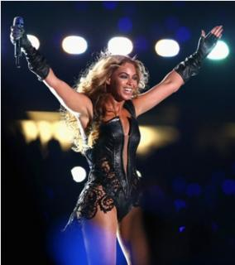
“Maybe the halftime show is as real as anything; what if some power or potent agency lives in it? Not a show but a means to something, something conferred or evoked. A ceremony. Something religious, so long as ‘religious’ extends to such cold-blooded concepts as mayhem, chance, nature out of control” (235).
“Carrying the show in front of 40 million people makes her one of the top human beings on the planet, and what strength of nerve that must take, what freakish concentrations of soul and energy” (237)

Slide 18
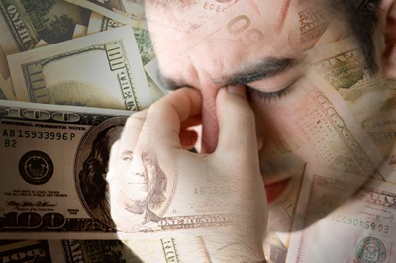
“MONEY MAKES US REAL” (266)
“So what do you believe in? . . . How about . . . reality.”
“Maybe the halftime show is as real as anything”
This is where the money lives, an integer-based realm of code and logic, geometric modules of cause and effect. . . . It seems the airiest thing there is yet the realest, but how you enter that world he has no idea…

Slide 19
“WHY MAKE A MOVIE [or write a novel] anyway?” (288)
The Fox News footage “is so real it looks fake.”
“Nothing looks so real as a fake, apparently, though ever since seeing the footage for himself Billy has puzzled over the fact that it doesn’t look like any battle he was every in. Therefore you have the real that looks fake twice over, the real that looks so real it looks fake and the real that looks nothing like the real and thus fake, so maybe you do need all of Hollywood’s craft and guile to bring it back to the real” (289).
Do we need the novelist’s craft?

Slide 20
Inside the (Real?) Fox Universe
“At dinner that night Bill O’Reilly raged on the TV…” (103).
“Billy heard somewhere that she is the latest American Idol, and like all the American Idols pint-sized or not she is blessed with a huge barrel of a mouth” (204).
“Meg Ryan was the lead in that chopper flick [Courage Under Fire], the one she did with Denzel a couple of years ago. . . . Hillary won a goddam Oscar playing a guy [in Boys Don’t Cry]. Well, playing a girl playing a guy, but whatever” (6).
“JAMIE LEE CURTIS MADE A SHITTY MOVIE [True Lies]” (156).
“Billy flashes on the palace orgy scene [of Conan the Barbarian], James Earl Jones playing the snake king
Bravo Company (Homeland)!

Slide 21

Ben Fountain works for Rupert Murdoch (sort of)…

Slide 22
What is “Autonomous Art”?
“Once artefacts become commodities in the market place, they exist for nothing and nobody in particular, and can consequently be rationalized, ideologically speaking, as existing merely and gloriously for themselves.”
          Terry Eagleton, The Ideology of the Aesthetic, 9.
Autonomous art is necessarily contradictory. It flourishes in the marketplace, but manages to represent a realm of freedom beyond capitalism. Beholden to no one in particular, autonomous art shows social relations as they might be.
Or, put differently: autonomous art dramatizes in experiential terms contradictions between what is, and what might be.

Slide 23
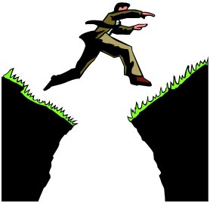
Chasms and Contradictions
“A kind of abyss separates the war over here from the war over there, and the trick, as Billy perceives it, is not to stumble when jumping from one side to another” (197).

Slide 24
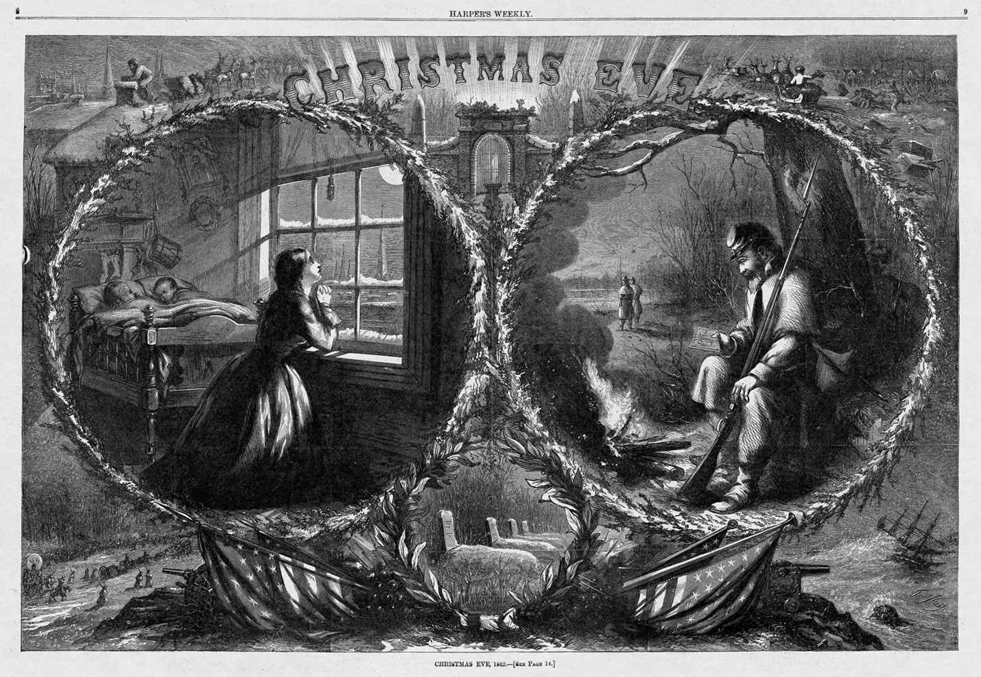
“Sentimental Domesticity” reconciled with the harsh realities of war.

Slide 25
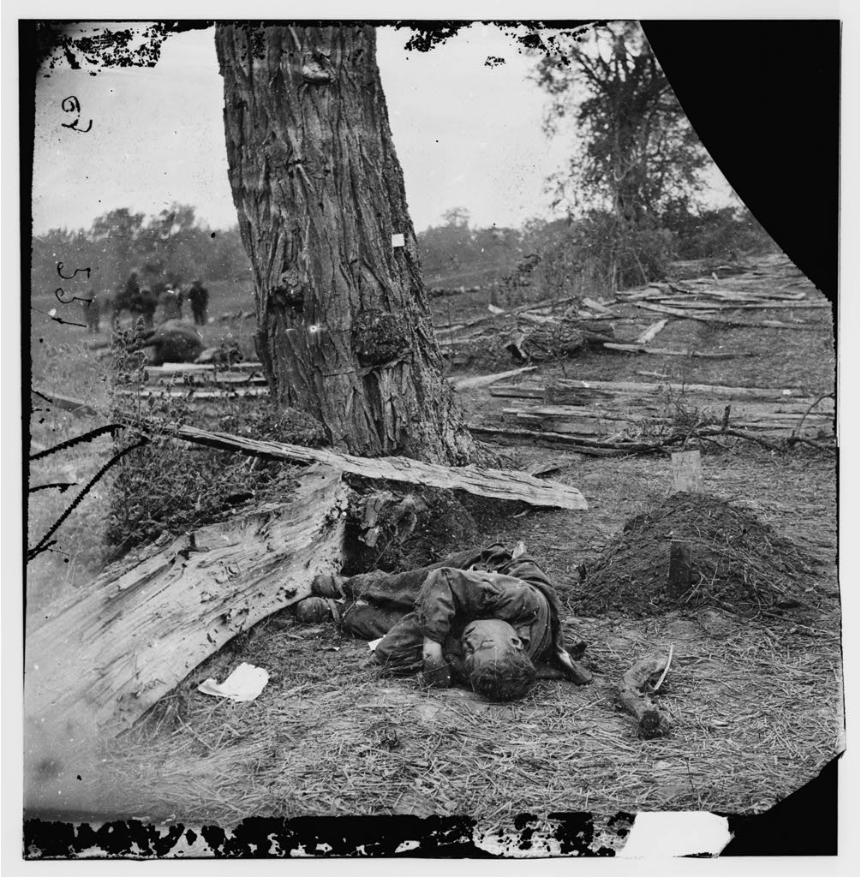
Photography as
Rupture.
Photographs disrupt the sentimental imagination

Slide 26
“. . . it dawns on Billy that these smiling, clueless citizens are the ones who came correct. For the past two weeks he’s been feeling so superior and smart because of all the things he knows from the war, but forget it, they are the ones in charge, these saps, these innocents, their homeland dream is the dominant force. His reality is their reality’s bitch; what they don’t know is more powerful than all the things he knows. . .” (306).
“Their reality dominates, except for this: It can’t save you” (306)
“How much reality can unreality take?” (307).

Slide 27
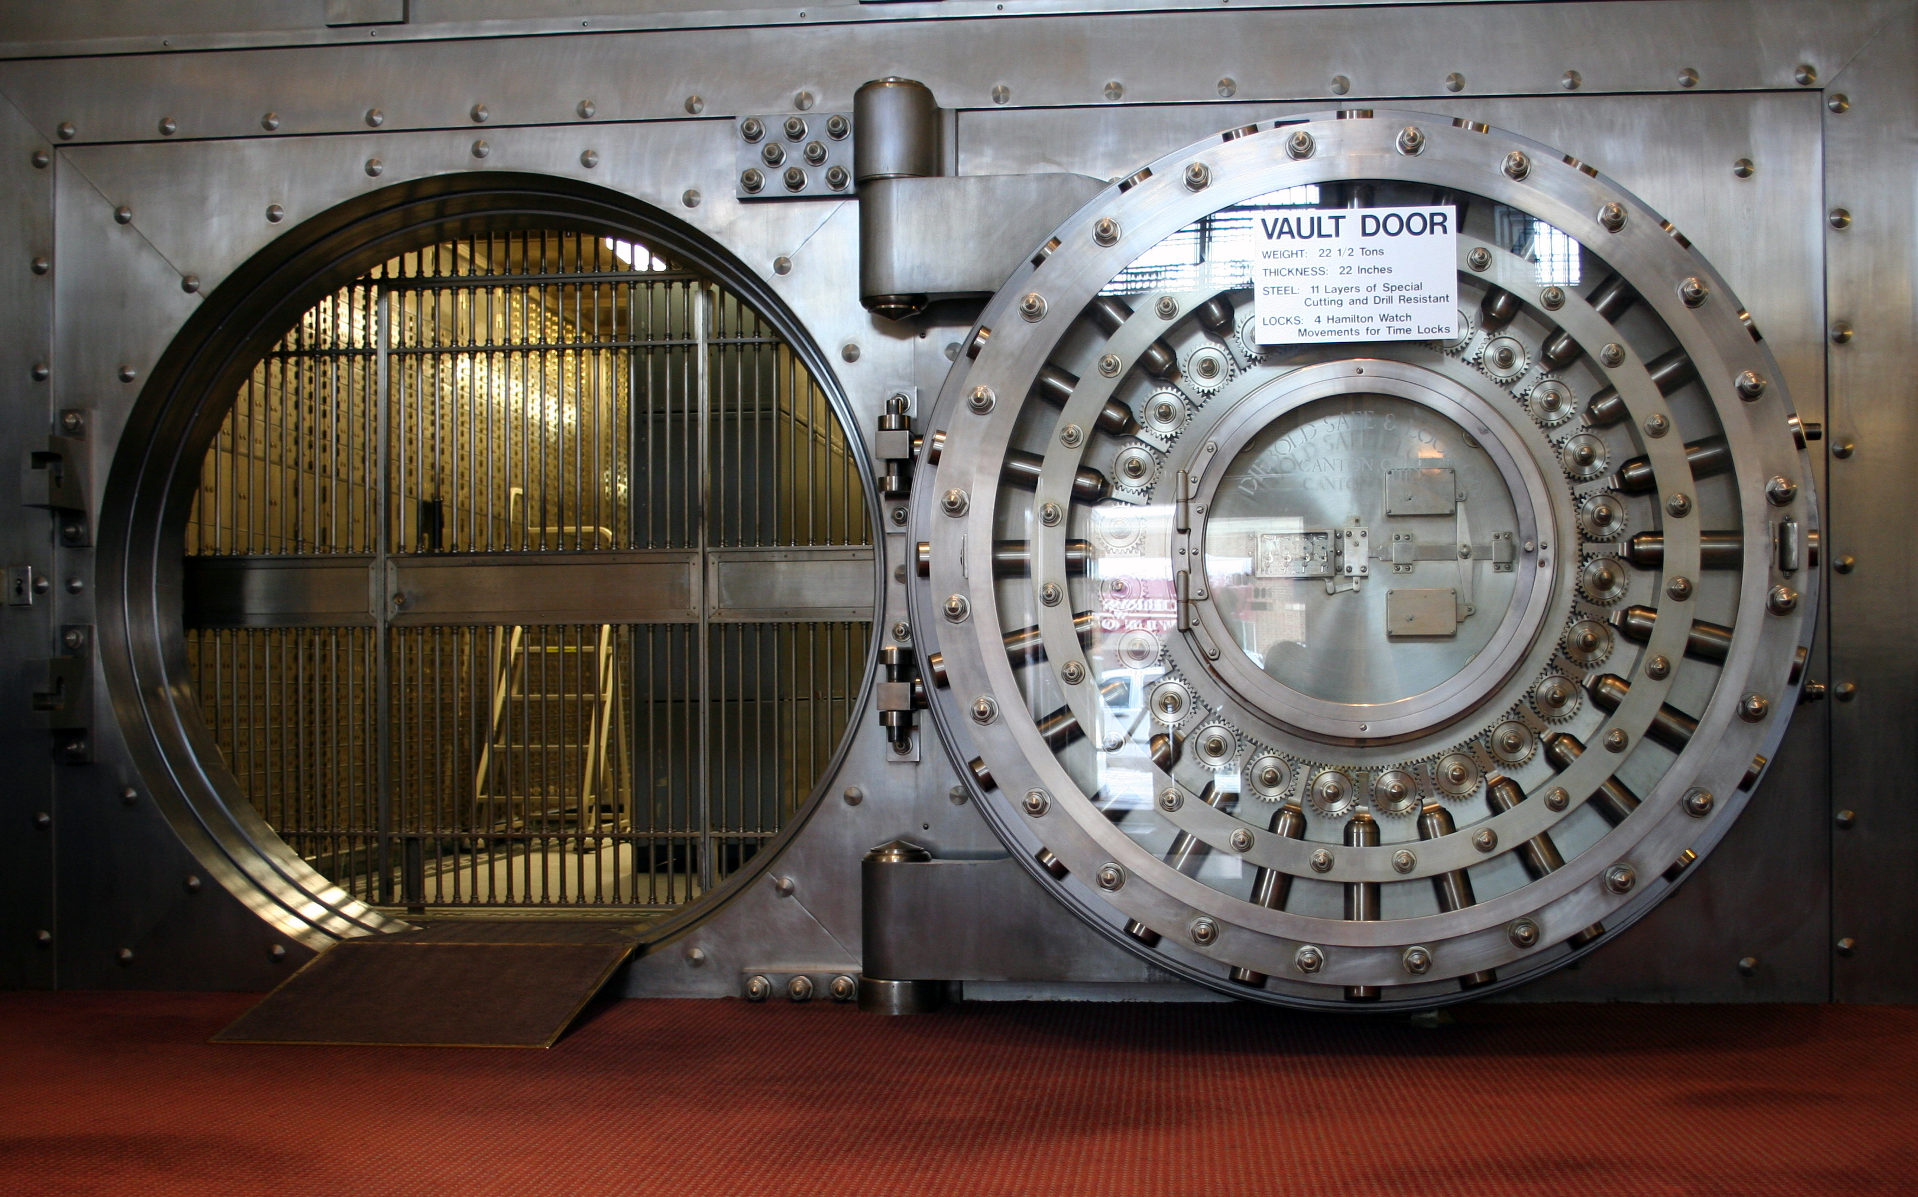
“And yet he knows, at least he thinks he knows, he feels it seeded in the purest certainty of his grief as he finds his seat belt and snaps it shut, that snick like the final lock of a vast and complex system. He’s in. Bound for the war. Good-bye, good-bye, good night, I love you all. He sits back, closes his eyes, and tries to think of nothing as the limo takes them away” (307).

